Slide 1
Ninjabot – System Architecture
Scraper/ Analyzer
Bookmarklet
Browser
Send URL and User Agent
Web Page
Objects :
Table
Scripts
Links
Images
And more
Objects
Table
Scripts
Links
Images
And more

Slide 2
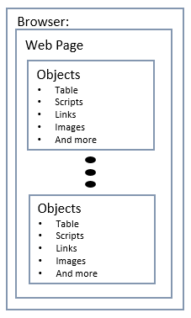
Ninjabot – System Flow Architecture
Scraper& Analyzer
Bookmarklet
Windows Chrome
Windows Firefox
URL LIST
Scraper
Queue URL
Request URL’s Robots.txt
Process Robot Params
Request Web Page
Split Objects and URL
Check URL against Robots Params
Request approved URL resource
Android Chrome
Android Firefox
Analyzer
Checks for any URL sends back to Scraper (5)
Analyze each functions and where is the end function.
More to come…
Database

Slide 3
Ninjabot – System Architecture
URL LIST
Scraper/ Analyzer
Bookmarklet
Send URL and User Agent
Browser:
Web Page
Objects
Table
Scripts
Links
Images
And more
Objects
Table
Scripts
Links
Images
And more

Slide 4



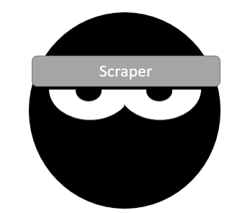

Scraper
Scraper

Slide 5


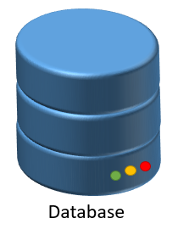

Browser
Database
+
-
x

Slide 6

Ninjabot System Architecture
Analyzer

